Slide 1

Chapter 1
Introduction to English and Part of Speech

Slide 2
What you will learn
Chapter 1 Introduction to English and Part of Speech
Chapter 2 Introduction to English Sentences
Chapter 3 Introduction to English Tenses
Chapter 4 Introduction to Active and Passive Voice
Chapter 5 Introduction to Modal Auxiliary
Chapter 6 Infinitives, Gerunds, and Causative
Basic Structure of English sentence
Introduction to part of speech (Noun, Pronoun, Verb, Adjective, etc)
Quiz
Positive
Negative
Interrogative
Quiz
Simple tenses
Past tenses
Future tenses
Quiz
Active Voice
Passive Voice
Quiz
Modal Auxiliary Verb
Explanation + Example
Quiz
Mini Project
Infinitives
Gerunds
Causative
Quiz
Chapter 7 Comparison Degree
Chapter 8
Asking and Giving Opinions
Chapter 9
Hobbies and Skill
Comparative degree
Superlative degree
Quiz
Asking and giving opinions
Quiz
Self introduction
Final Project

Slide 3
Why English?

Slide 4
Basic Structure of English sentence
Subject + Verb + Noun
Example:
Verb
Verb
Noun
Subject
Noun
Subject
I study English
I am watching a movie
Subject + Verb + Adjective
Example:
She is pretty
They are smart
Subject
Verb
Adjective
Subject
Verb
Adjective

Slide 5
Cheat sheet
Subject | Verb | To be
I, You, They, We | Verb 1/Infinitive | am (especially for I) and are (you, they, we)
She, He, It | Verb + s/es | is
Example:
She kisses her cat
He runs so fast
It is so beautiful
I do my homework
You are special
They look at me
We ride a roller coaster

Slide 6
Part of Speech

Slide 7
Noun
Kata benda / objek / subjek
an apple
a butterfly
“A noun is a thing, a person, or a place”
Noun is usually used with an article “a” or “an”.
Article “a” is for a noun with consonant sound
Article “an” is for a noun with vowel sound.
a star
an umbrella
Noun can also be an Object
Object is the thing or a person that receives the action.
Noun can also be singular or plural
Example:
Book / Books
Country / Countries
Month / Months
Laptop / Laptops
Cat / Cats
Dog / Dogs
Pizza / Pizzas
Family / Families

Slide 8

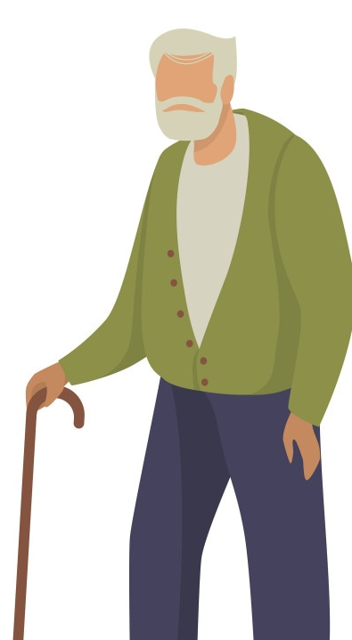
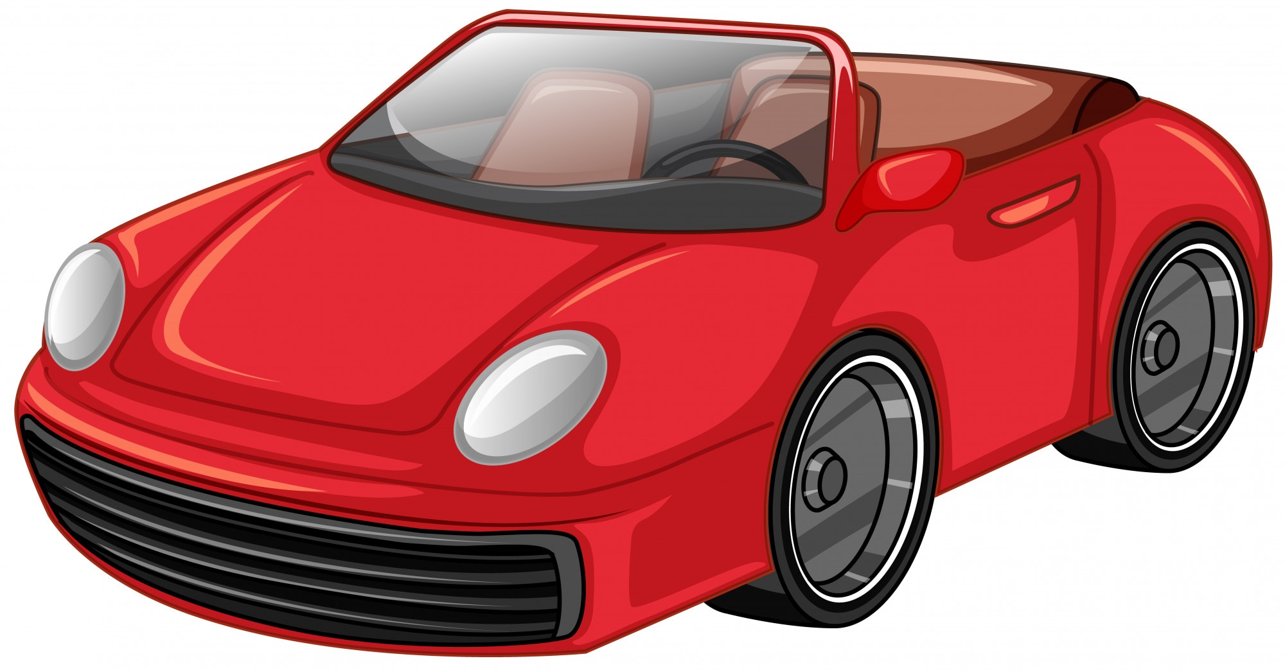

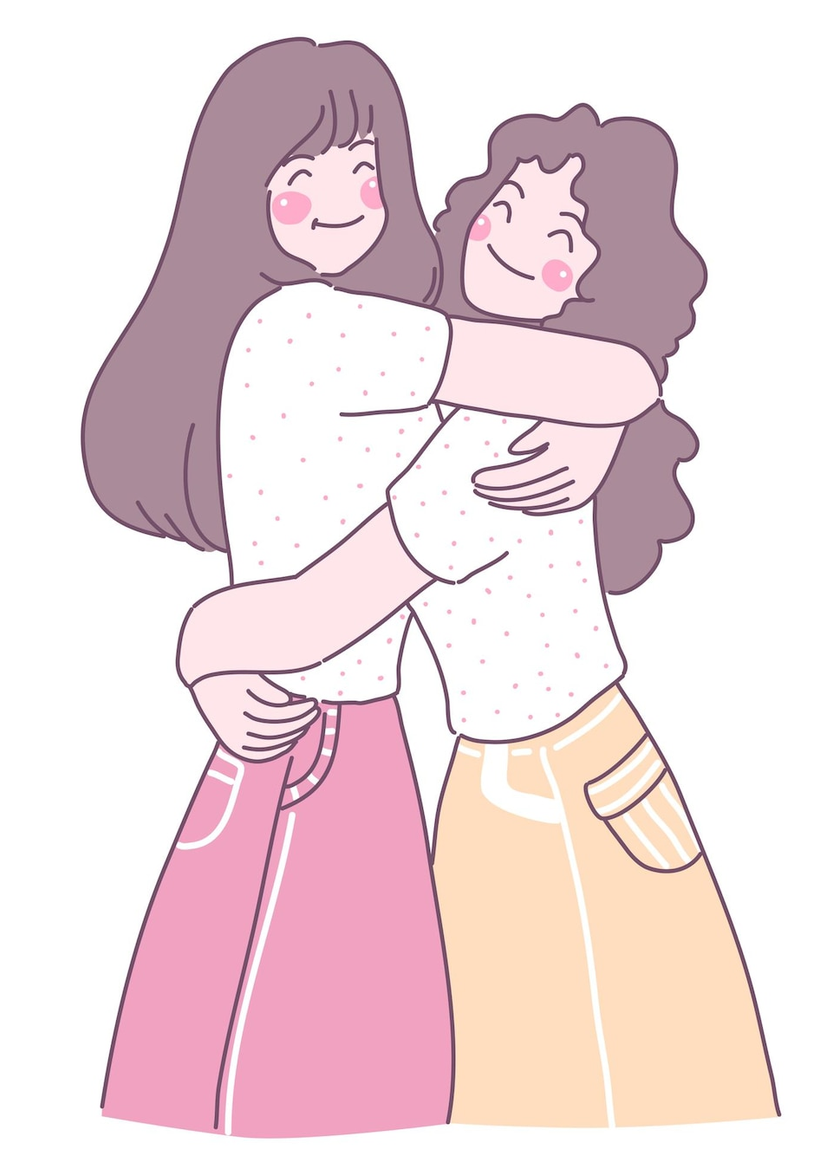
Noun
Objective complement is a noun, adjective, or pronoun used in the predicate as complement to a verb and as qualifier of its direct object.
Example:
A red car
A young girl
An old man
A brown suitcase
A best friend

Slide 9
Verb
Kata kerja
Verb can be divided into 3 parts; Verb 1, Verb 2, Verb 3
Type | Definition | Example
Verb 1 | The most basic verb | Drive, Eat, Sleep, Talk, Put, Take
Verb 2 | To describe past events | Drove, Ate, Slept, Talked, Put, Took
Verb 3 | To describe action that has been done | Driven, Eaten, Slept, Talked, Put, Taken

Slide 10
Pronoun
Kata ganti
“Pronoun replaces a noun”
Pronouns are I, you, she, some, me
Example:
Some days are colder in Autumn.
Tanya is sick. She will not be able to go home alone.

Slide 11
Adjective
Kata sifat
A word that describe a noun or pronoun or an event.
Example :
Our country, Indonesia, is so rich.
This pandemic has been very frustrating.
My boyfriend is a good man.
Istana Merdeka is so enormous.
Squid Game was so popular back in 2021.

Slide 12
Adverb
Kata keterangan
Adverb describes verb, adjective, but not noun.
Usually adverb is followed by –ly at the end of the word.
Example :
The queue was very long.
The traffic jam was extremely bad yesterday.
Press the lid gently to open it.
The burglar ran so quickly after someone saw him.

Slide 13
Preposition
Kata depan
Preposition is placed before noun or pronoun .
For example: for, in, on, at, by, about, with, to, and etc.
Preposition can also describe the position of a noun or pronoun, like: behind, between, under, near, beside, etc.
Example :
The hotel is near the bus stop.
I live in Indonesia.
I saw the video on Instagram.
I work at Google.

Slide 14
Conjunction
Kata sambung
Conjunction connects words, clauses, or phrases.
For example; and, but, or, nor, so, yet, for, etc.
Example :
I had hamburger, taco, and lemon tea for lunch today.
He is a rebel but his grades are always good.
I haven’t visited New York yet.
Neither Susan nor Susi wants to leave the room.

